Slide 1


Neighborhood-Aware Scalable Temporal Network Representation Learning
Yuhong Luo
University of Massachusetts (Master’s)
^{LoG Conference 2022}
Notes:
Hello everyone! Thanks for coming to my talk.
It is my great pleasure to present our work on Neighborhood-Aware Scalable Temporal Network Representation Learning, which got the best paper award at the LoG conference
My name is Yuhong Luo

Slide 2



Collaborator
Pan Li
Purdue University (transferring to Georgia Tech. at 2023 Spring)
Notes:
This is a joint work with professor Pan Li of Purdue University during my summer internship.

Slide 3
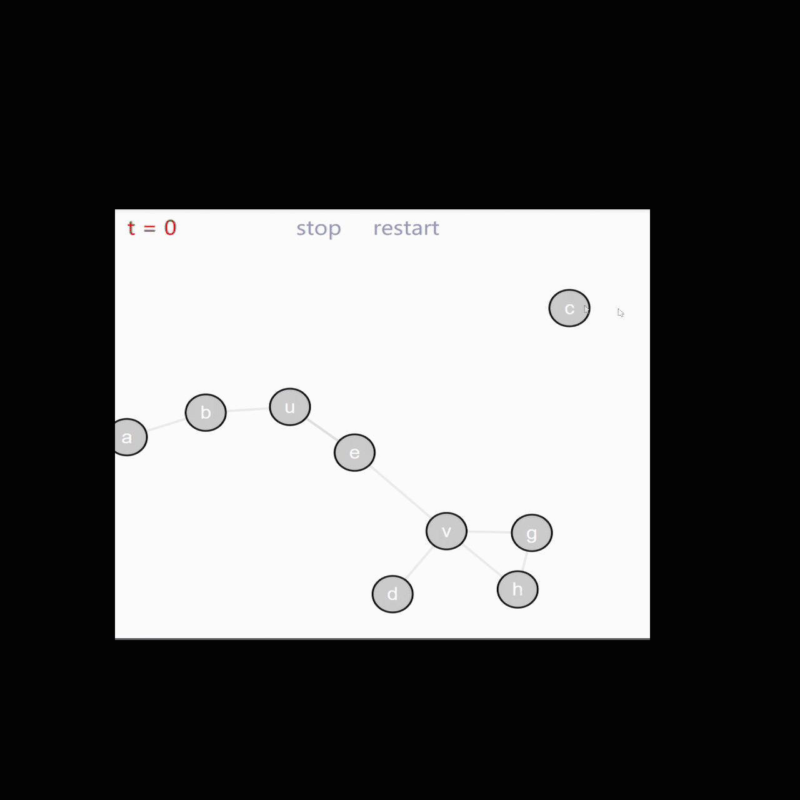

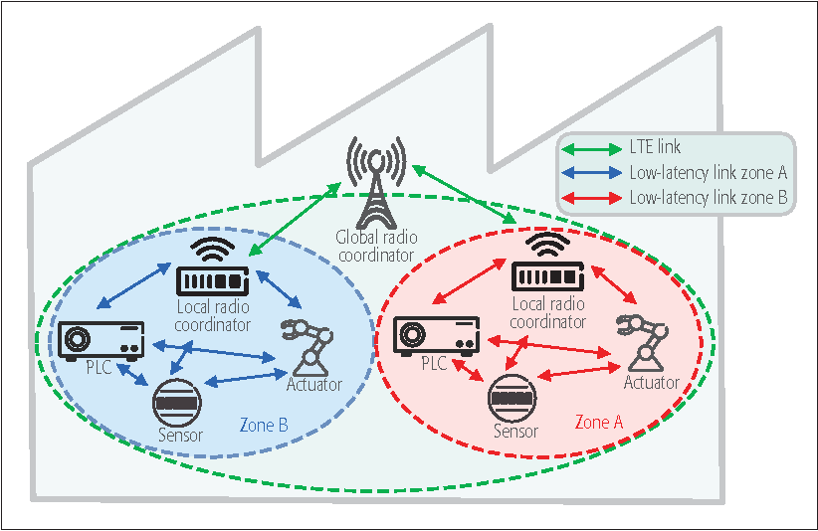
Temporal Networks
Abstraction of complex interactive systems.
Network structures evolve over time.
Email network
Social media network
User-item networks in recommender systems
Engineering control networks
Mobility networks
https://www.shortstack.com/blog/best-social-networks-to-reach-specific-demographics/
https://www.sciencedirect.com/science/article/pii/S0378873314000173
https://engineering.jhu.edu/magazine/2018/05/securing-the-power-grid/#.YF43g69KhPY
Notes:
Okay, since this is the temporal graph reading group, I guess I don’t need to emphasize on the importance temporal networks. But just to recap, temporal network is a type of more complex network that evolves over time. Temporal networks are widely used to model data in interactive systems, including email networks, social networks, an so on.

Slide 4
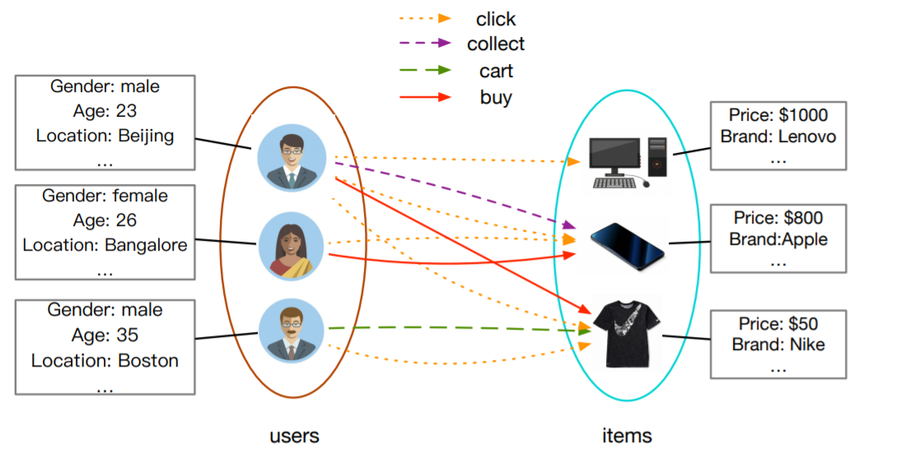
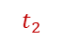
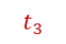
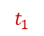
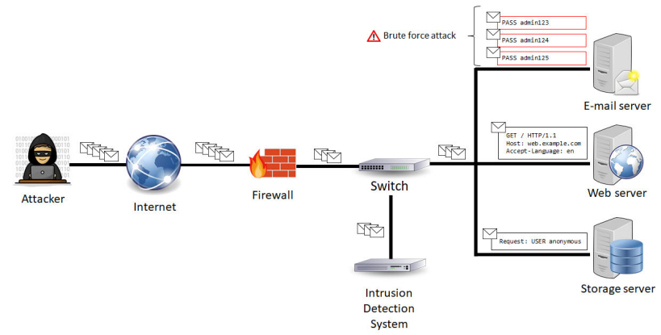
Our Goal
Predicting how temporal networks evolve
--- link prediction in temporal networks
Applications in …
Making recommendations
Detecting anomalies
Understanding a complex system
https://medium.com/criteo-engineering/top-applications-of-graph-neural-networks-2021-c06ec82bfc18
Network Anomaly Detection With Temporal Convolutional Network and U-Net Model, IEEE access 2021
Notes:
Our goal is to use representation learning to predict how temporal network evolves over time, or basically, to predict links.
We may find a wide range of applications on interaction predictions.
For example, when we model the interactive behaviors between users and items as temporal networks, we can use the predictions to make recommendations.
We can also detect network anomalies, when we observe an interaction that is against predictions.
Overall, predicting how temporal network evolves can help us understand a complex interactive system.

Slide 5
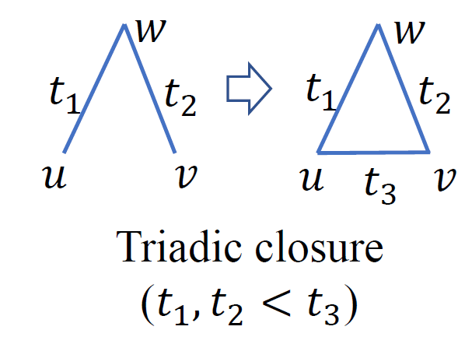

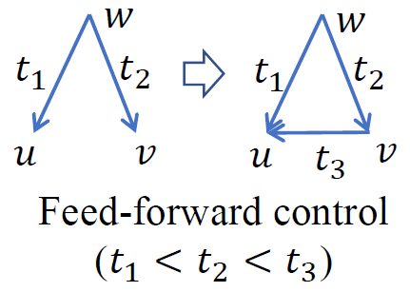
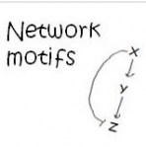
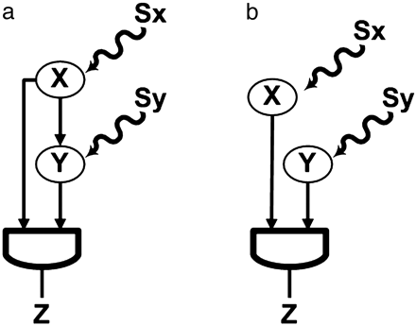
Temporal Networks in Network Science
Network science: How network structures evolves reflects the fundamental laws of these complex systems.
Laws:
Social Network: People with common friends tend to know each other (Simmel, 1950).
In biological/engineering control systems, positive stimuli are followed with negative stimuli (Mangan & Alon, 2003).
Notes:
To motivate our approach, I would like to highlight our understanding on temporal networks from the perspective of network science
In network science, researchers have found that a temporal network typically evolves according to some fundamental laws that indicate the dynamics of the system.
In the first example, social networks evolve following a law termed triadic closure.
The corresponding explanation is that if two people have a common friend, they are likely to know each other in the future, even though they don’t know each other right now.
There is another example called feed-forward control. In many biological systems or engineering control systems, there is always a feedback mechanism to make the system work in a stable sense.
Such a mechanism can be represented as a feed-forward control loop:
For example, gene W will stimulate the generation of protein u and later will stimulate the generation of another protein v that may prohibit the generation of u.
This feed-forward control loop also gives a fundamental law of these control system.

Slide 6
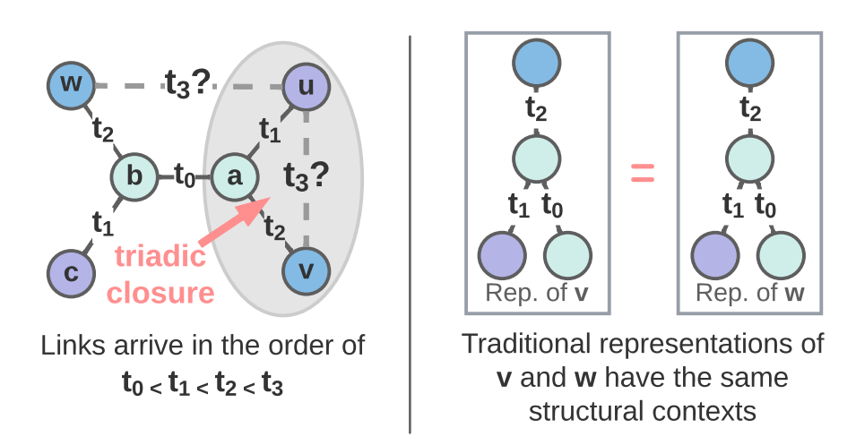
Issues of Previous Approaches (Effectiveness)
GNNs cannot capture structural features that involve multiple nodes of interest, such as triadic closure
a
[You et al. 2019]
[Srinivasan & Bruno 2020]
u
v
Temporal network representation learning, if following GNN-type computation, will fail to learn such information.
Position-aware Graph Neural Networks, You et al., ICML 2019
On the Equivalence between Positional Node Embeddings and Structural Graph Representations, Srinivasan & Bruno ICLR 2020
Notes:
Okay, now let us see whether previous models on temporal networks can capture those laws.
Many previous works try to extend graph neural networks to temporal networks.
However, we argue that most of these works will fail to capture such laws.
Let us see an example here. In this toy temporal network. We want to predict whether node u is to interact with node v or node w at timestamp t3.
Intuitively, u is more likely to interact with node v because of the law of triadic closure.
U and v have a common neighbor a but u and w do not have a common neighbor.
However, GNN-type model will fail here because node w and node v are symmetric here.
They have the same computing graph so the model cannot distinguish them.
Actually, GNN-type computation fails to capture some structural features that involve multiple nodes of interest.
Here, the important structural feature is this wedge uav that implies triadic closure of nodes u,v of interest.

Slide 7
Issues of Previous Approaches (Effectiveness)
Works over static graphs
SEAL (Zhang et al. 2018)
Distance encoding (Li et al. 2020)
Labeling trick (Zhang et al. 2021)
SUREL (Yin et al. 2022)
ELPH (Chamberlain et al. 2022)
Key idea: Construct structural features
[1,1]
Distance encoding
Take distance encoding (Li et al. 2020) as an example:
a
To make a prediction for (u,v), associate a with an extra feature [1,1] to denote its shortest path distances to both u and v are 1’s.
u
v
What is suitable for temporal networks? Effective & scalable
Distance encoding: design provably more powerful neural networks for graph representation learning, Li et al. NeurIPS 2020
Labeling trick: A theory of using graph neural networks for multi-node representation learning, Zhang et al. NeurIPS 2021
Notes:
This is not a new observation in the study of static networks.
Till now, many works on static networks have been proposed to address this issue.
The common idea behind these works is to construct structural features that involve the multiple nodes of interest.
Interested audient may want to check these work to know more details.
As an example, if we use distance encoding, when we make prediction for node pair u and v, we may label a as (1,1) as its shortest path distances to u and v are both 1.
The question is how to generalize this idea to temporal networks to guarantee the effectiveness and scalability.

Slide 8
Issues of Previous Approaches (Effectiveness)
Traditional GNNs cannot capture structural features that involve multiple nodes of interest, such as triadic closure.
[You et al. 2019]
[Srinivasan & Bruno 2020] [Li et al. 2020]
a
u
v
Temporal network representation learning, if following GNN-type computation, will fail to learn such information.
DyRep (Trivedi et al., 2017; 2019); JODIE (Kumar et al., 2019);
TGN (Rossi et al., 2020); TGAT (Xu et al., 2020);
Position-aware Graph Neural Networks, You et al., ICML 2019
On the Equivalence between Positional Node Embeddings and Structural Graph Representations, Srinivasan & Bruno ICLR 2020 Distance encoding: design provably more powerful neural networks for graph representation learning, Li et al. NeurIPS 2020
Notes:
1:40
Okay, now let’s see whether previous models on temporal networks can capture those laws.
Many previous works try to extend graph neural networks to temporal networks.
However, we argue that most of these works will fail to capture those laws.
Let’s see this toy example. In this temporal network, we want to predict whether node u is going to interact with node v or node w at timestamp t3.
Intuitively, u is more likely to interact with v because of triadic closure.
U and v have a common neighbor a but u and w don’t have a common neighbor.
However, GNN-type model will fail to differentiate node w and node v because they are symmetric.
They have the same computation graph and the same representation.
More fundamentally, GNN-type computation fails to capture some structural features that jointly consider multiple nodes of interest.
Here, an important structural feature is the neighborhood consists of u,a and v. It implies triadic closure of nodes u and v.
This problem is naturally carried over to Temporal GNNs.
# There has been many works proposed to address this issue for static graphs, such as position encoding, distance encoding, etc. However, this is still relatively new in temporal networks.

Slide 9
Issues of Previous Approaches (Effectiveness)
Works over static graphs
SEAL (Zhang et al. 2018)
Distance encoding (Li et al. 2020)
Labeling trick (Zhang et al. 2021)
SUREL (Yin et al. 2022)
ELPH (Chamberlain et al. 2022)
Key idea: Construct structural features
[1,1]
Distance encoding
Take distance encoding (Li et al. 2020) as an example:
a
To make a prediction for (u,v), associate a with an extra feature [1,1] to denote its shortest path distances to both u and v are 1’s.
u
v
What is suitable for temporal networks? Effective & scalable
Distance encoding: design provably more powerful neural networks for graph representation learning, Li et al. NeurIPS 2020
Labeling trick: A theory of using graph neural networks for multi-node representation learning, Zhang et al. NeurIPS 2021
Notes:
This is not a new observation in the study of static networks.
Many works on static networks have been proposed to address this issue.
The common idea behind these works is to construct structural features that involve the multiple nodes of interest.
Interested audient may want to check these work to know more details.
Here we give a brief example, if we use distance encoding, when we make prediction for node pair u and v, we may label a as (1,1) as the shortest path distances to u and v are both 1.
The question is how to generalize these ideas to temporal networks to guarantee the effectiveness and scalability.

Slide 10
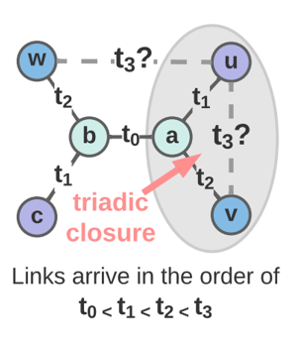
Issues of Previous Approaches (Scalability)
One recent work over temporal networks that captures structural features
CAWN [Wang et al. 2021]
a
u
v
Computational Overhead of CAWNs:
For each queried node pair, random walks need to be sampled.
The relative position encoding needs to be computed online.
Inductive Representation Learning in Temporal Networks via Causal Anonymous Walks, Wang et al., ICLR 2021
Notes:
50
There is one recent work called CAWN that captures such structural features on temporal networks.
However, there is a huge computational overhead with CAWN.
Essentially, for each queried node pair say u and v, we need to sample multiple random walks for both u and v based on historical events.
We further need to compute relative positional encoding online, which is the key design that can represents the structural feature such as the u,a,v.
Both of these operations are time consuming.

Slide 11
Neighborhood-Aware Temporal Network (NAT)
Dictionary-type Node Representations
Constructs structural feature Efficiently
Avoids online neighbor sampling
Neighborhood Caches (N-Caches)
Maintains dictionary representations with parallel hashing scalably
Notes:
60
Now we introduce our approach, Neighborhood-Aware Temporal Network or NAT in short, that solves the effectiveness and the scalability issue simultaneously.
Overall, it has two novel designs.
First, it adopts dictionary-type node representations. which can construct structural features efficiently, while avoiding the expensive neighbor or walk sampling as commonly used in previous methods.
Secondly, it maintains those dictionary representations with a scalable data structure named neighborhood cache or N-Cache.
We won’t get into much detail about N-cache as it is more involved. If you are interested, please check our paper or come to the poster session to discuss more.
Next, we will introduce the first design and see how it achieves these goals.

Slide 12
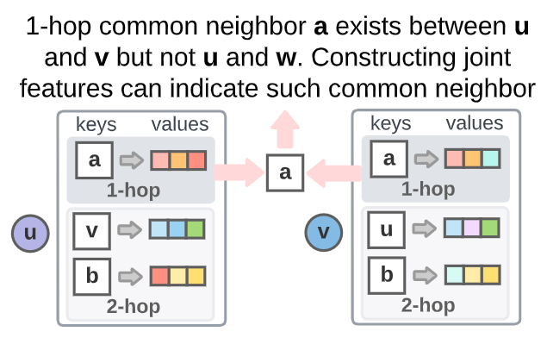
NAT - Dictionary Representations
Long-vector representations
Each node u is represented as a dictionary
Keys: Down-sampled neighbors in 0-hop (self), 1-hop, 2-hop,…
Values: Short vector representations (2~8 dim) --- e.g. representation for “node a as a neighbor of node u”
Notes:
The key idea behind the dictionary-typed representation is as follows.
Many previous works track a long vector representation for each node in the memory
Here, we don’t use such a long vector representation any more.
Instead, we adopt a dictionary-type node representation.
Such a dictionary records a down-sampled historical neighborhood of a certain node.
To better understand it, we use this toy example again. Suppose the timestamp now is t3, in this dictionary for node u, the keys are down-sampled neighbors around node u,
Here, a is a node in the first hop neighborhood of node u.
v and b are nodes in the second hop neighborhoods of node u, and etc.
The values of these keys are short vector representations, with some physical meaning. Take this vector with key a as an example. It summarizes interactions in the past when a is the first hop neighbor of u. This vector is not a representation of a single node, not u not a, It is actually a representation of this node pair (u,a)
Note that these vectors are not long, in our experiment, we often use a vector of length 2-8. So, the overall memory cost is comparable to previous methods.
# The size of the dictionary is not large either, we typically keep less than 32 neighbors in total for each node.
# which we typically call node embedding or node representation. It encodes all temporal and spatial features of a node.

Slide 13
NAT - Dictionary Representations
How to?
Constructs structural feature efficiently
Avoids online neighbor sampling
Notes:
How can the dictionary representations help us constructs structural features while being computationally efficient?
Let’s use an example to understand how it works.

Slide 14
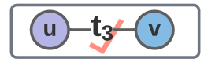
NAT - Feature Constructions
Consider:
Aggregate two relative positions (0,1,0), (0,1,0)
Indicating a common neighbor here!
For node a:
Denote that this node is in first hop
Notes:
Suppose now we have the dictionary representations for all nodes and we want to predict whether node u will connect with node v at time t3. We don’t need to sample neighboring nodes anymore. Instead, we join their representations in the dictionaries of u and v corresponding to same keys.
Here, we capture the structural feature through relative positional encoding. For node a as an example, because it appears in the first hops of both dictionaries, we just aggregate two (0,1,0) vectors as the relative positions.
(0,1,0) denotes the appearance in the first hop. This aggregation indicates that a is a common neighbor of u and v.

Slide 15
NAT - Feature Constructions
Consider:
Aggregate two relative positions (0,1,0), (0,1,0)
Indicating a common neighbor here!
For node a:
Denote that this node is in first hop
Captures joint neighborhood structural features between u and v
a
u
v
Notes:
It is capable of encodes the structural features of the neighborhood u,a and v as mentioned previously.
# We call this joint neighborhood structural features between u and v.

Slide 16
NAT - Feature Constructions
Consider:
Aggregate two representations (e.g., sum pooling)
Aggregate two relative positions (0,1,0), (0,1,0)
For node a:
For node b: …
works like a traditional vector representation
…
Done in parallel for all nodes in the dictionaries of u and v
Notes:
Besides relative positional encoding, we also aggregate the values or the short vector representations according to the keys.
This operation works like traditional vector representations.
We can do similar operations for all nodes with keys in the dictionaries in parallel.

Slide 17
NAT - Feature Constructions
Consider:
Aggregate two representations
(e.g., sum pooling)
Aggregate two relative positions (0,1,0), (0,1,0)
For node a:
NAT combines structural feature construction and traditional vector representations
works like a traditional vector representation
Done in parallel for all nodes in the dictionaries of u and v
Notes:
One important note here is that dictionary representations essentially combine structural feature construction based on the keys and traditional vector representations based on the values.

Slide 18
NAT - Feature Constructions
Consider:
make prediction
Aggregate two representations
(e.g., sum pooling)
Aggregate two relative positions (0,1,0), (0,1,0)
For node a:
For node b: …
…
Done in parallel for all nodes in the dictionaries of u and v
Notes:
With these two aggregated representations for all nodes, we combine them together to make the final prediction.
Overall, we can see that when doing inference, NAT avoids the expensive neighbor sampling.
Moreover, the computation of relative positional encodings and aggregation of short vector representations are done in parallel, which saves a lot of time.

Slide 19
Neighborhood-Aware Temporal Network (NAT)
Dictionary-type Node Representations
Constructs structural feature Efficiently
Avoids online neighbor sampling
Neighborhood Caches (N-Caches)
Maintains dictionary representations with parallel hashing scalably
Notes:
So, we know that the dictionary representations are useful. But how do we store and update these representations efficiently?
We introduce Neighborhood Caches (N-Caches) that maintains these representations in a scalable way.

Slide 20
NAT - Neighborhood Caches
Goals of the data structure to store dictionary representations
Maintainable size
Stores only a subset of neighbors
Fast random access/update
Hashes on IDs
GPU parallelization
Parallelizable
Notes:
First, let’s consider what we want to achieve from the storage perspective.
To ensure the memory size is maintainable, we want to set a size limit for the dictionary representations. We already use short vector for the representations. To further control the size, we only stores the dictionary representations for a subset of neighbors.
Secondly, because the dictionary representation is a summarization of past interactions between two nodes, when new links come in, we need random access and update to the dictionary representations efficiently.
For that, we use hashing on the neighbor node IDs.
Finally, we have to process a batch of nodes at a time, so parallelism is important and we use GPU implementation to achieve that.

Slide 21
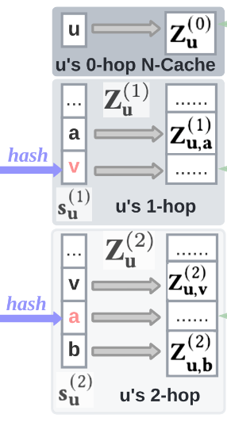
NAT - Neighborhood Caches
N-Caches
–– Fixed size hash tables in the GPU
Stores only a subset of neighbors
Hashes on IDs
GPU parallelization
N-Caches of u
Notes:
Given these 3 ideas, we introduce a data structure called N-cache that is essentially a GPU hash table.
On the right is an example of N-cache for node u.

Slide 22
NAT - Neighborhood Caches
N-Caches
–– Fixed size hash tables in the GPU
Stores only a subset of neighbors
Hashes on IDs
GPU parallelization
Neighbor IDs
N-Caches of u

Slide 23
NAT - Neighborhood Caches
N-Caches
–– Fixed size hash tables in the GPU
Dictionary
Reps
Stores only a subset of neighbors
Hashes on IDs
GPU parallelization
Neighbor IDs
Notes:
We keep track of Neighbor IDs as the keys and the dictionary representations as values.

Slide 24
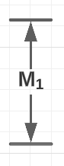
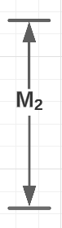
NAT - Neighborhood Caches
N-Caches
–– Fixed size hash tables in the GPU
Stores only a subset of neighbors
Hashes on IDs
GPU parallelization
Notes:
We introduce hyperparameters to control the size of the N-caches. M1 for the first hop and M2 for the second hop

Slide 25
NAT - Neighborhood Caches
N-Caches
–– Fixed size hash tables in the GPU
Stores only a subset of neighbors
Hashes on IDs
GPU parallelization
Notes:
We apply hashing on the neighbor IDs. Given a node ID, we apply a hash function to locate the index where the neighbor should belong to. Next, we will use an example to walk through how to update the dictionaries and how to handle hash collisions.

Slide 26
NAT - Neighborhood Caches
Consider:
To update the N-caches of u
Update 0-hop
Update 1-hop
Update 2-hop, …
Notes:
Now, let’s consider this example again. Given that we know u and v connects at t3. Now, we want to use this information to update the N-caches of u. We update the 0-hop, 1-hop and 2-hop N-caches respectively.

Slide 27
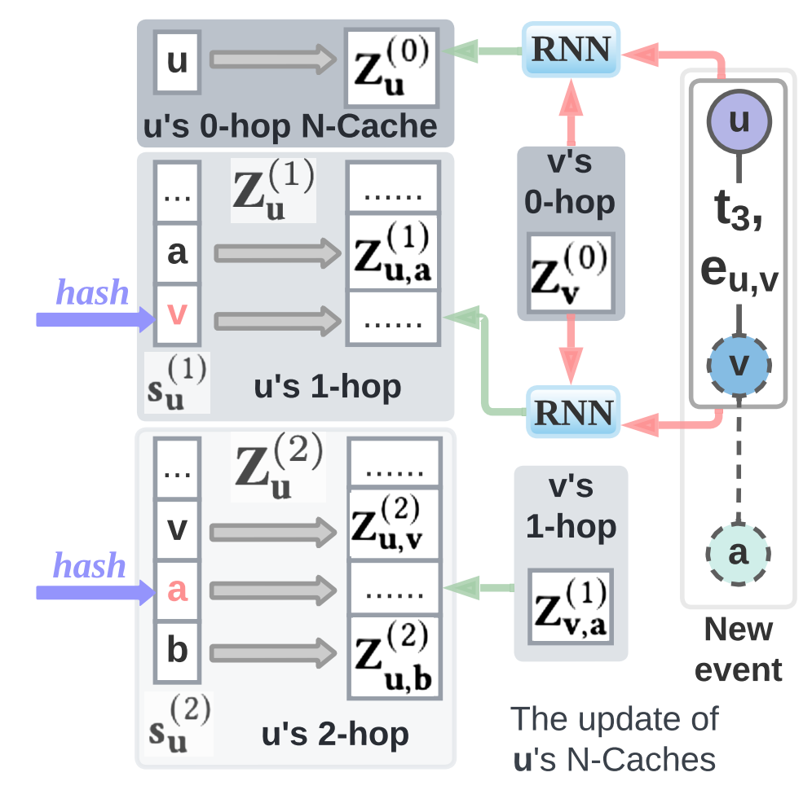
NAT - Neighborhood Caches
Consider:
To update the N-caches of u
Update 0-hop
Notes:
For 0-hop, it is pretty straight forward. it is essentially a node representation. We update it with an RNN. For input, we use the 0-hop representation of the opposing node and the features associated with the new link.

Slide 28
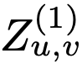
NAT - Neighborhood Caches
Consider:
To update the N-caches of u
Update 1-hop
Compute
Check position hash(v)
If key is empty or is v itself, then insert value
Otherwise, COLLISION! Replace randomly
Notes:
First hop is relatively more complicated. Basically, it follows these steps.
First, we use another RNN to produce the new dictionary representation Zuv when v is the first hop neighbor of u.
After that, we apply the hash function on v. If that position is empty, or it is already occupied by v, then we insert the new dictionary representation.
Otherwise, it is a collision. In that case, we flip a coin and replace the occupants randomly. If we favor new links, then the probability of replace should be higher.

Slide 29
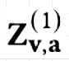
NAT - Neighborhood Caches
Consider:
To update the N-caches of u
Update 2-hop
Access
Check position hash(a)
If key is empty or is a itself, then replace
Otherwise, replace randomly
All updates are performed within GPU in parallel for all nodes in a minibatch
Same as 1-hop
Notes:
Second hop is very similar. Except that we don’t need to calculate the representation anymore. In this example, a is a second hop neighbor of u and also a first hop neighbor of v. To update the 2-nd hop n-cache, for simplicity, we just use the first hop representation Zva.
The rest of the hashing and replacement are the same as the first hop update.
Notice that all of these updates are performed in GPU. So we update for all nodes in the same minibatch in parallel.

Slide 30
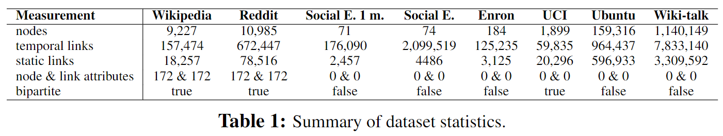
Experiments
Old
nodes
New
nodes
Train
Test
t
0%
85%
100%
Inductive:
✗
✓
✓
✗
✗
✓
Transductive:
✓
✓
✓
✓
✓
✓
Notes:
Now, we want to show some evaluation of the model. We consider two types of tasks in our experiment: inductive and transductive learning.
The inductive setting splits nodes into two sets, the “old” nodes and “new” nodes. During the training, we only see links between old nodes, and during the testing, we predict links attached to the new nodes.
The transductive setting is simpler. We train on all the links up to a certain point in time, and test on the rest.
Also, these are the datasets used for our evaluation. Note that here, we have a relatively large network wiki-talk with more than 1M nodes and 7M edges.

Slide 31
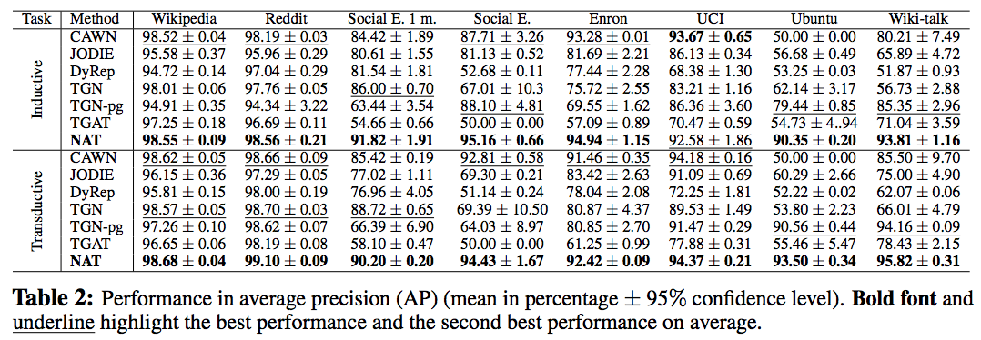
Prediction Performance (AP)
Effective node/edge features
No node/edge features
NAT performs the best
Notes:
Let’s first see the prediction performance.
In almost all cases, NAT achieves the first place.
CAWN also performs well overall. We think this is because both NAT and CAWN captures structural features.
While nat also combines the advantages of traditional vector representations.
CAWN is comparable with TGN when there are valid node/edge features and can mostly outperform TGN when there are not valid node/edge features. We think this is because both NAT and CAWN captures structural features.

Slide 32
Prediction Performance (AP)
On large networks (ubuntu/wiki-talk), TGN-pg can outperform CAWN while being worse than NAT. We guess it is because the two networks are sparse. One needs to join structural features and vector representations.
(TGN-pg: PyTorch Geometric implementation of TGN)
Notes:
Optional
However, On large networks (ubuntu/wiki-talk), TGN-pg a pytorch geometric implementation of TGN, can outperform CAWN while still being worse than NAT. We guess it is because the two networks are sparse. By sampling limited numbers of random walks, CAWN may not always construct effective structural features. We needs to join structural features with traditional vector representations, which is done by NAT.

Slide 33
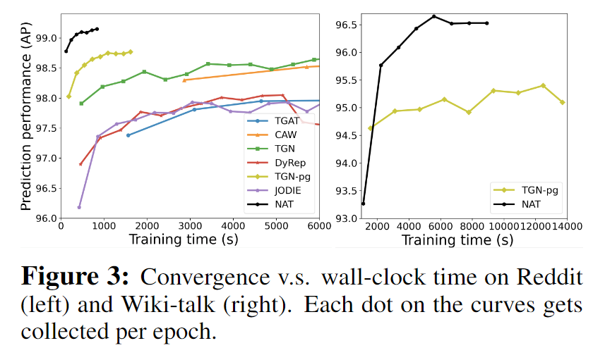
Computation & Scalability
Hardware:
i7-4770HQ CPU @ 2.20GHz + GeForce GTX 1080 Ti
Training wall-clock time: NAT is super fast
Notes:
Furthermore, we also evaluate the computation and scalability.
The hardware used is listed as above.
These two figures show the training dynamics.
That is the wall clock time v.s. the validation performance.
We can see NAT achieves very high accuracy in a very short time.

Slide 34
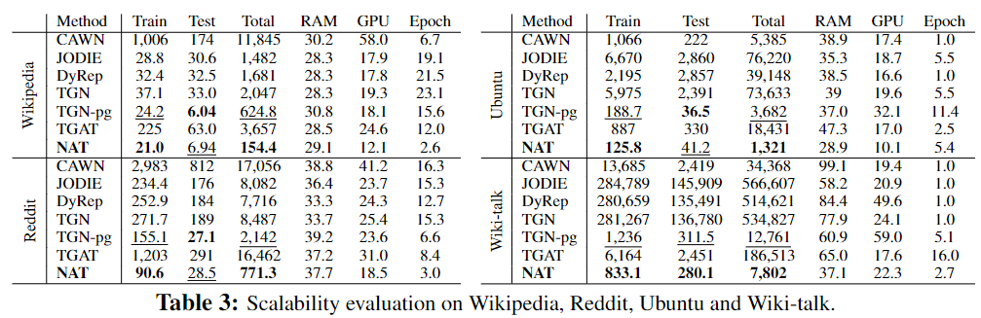
Computation & Scalability
Hardware:
i7-4770HQ CPU @ 2.20GHz + GeForce GTX 1080 Ti
NAT is fast
2-4 times faster than TGN-pg in training
Comparable in inference
(TGN-pg: PyTorch Geometric implementation of TGN)
Notes:
Here are some more details of time usage.
NAT is the fastest.
It is about 2-3 times faster than TGN-pg in training while achieves comparable latency with TGN-pg in inference.

Slide 35
Computation & Scalability
Hardware:
i7-4770HQ CPU @ 2.20GHz + GeForce GTX 1080 Ti
JODIE/DyRep/TGN cannot fill node embeddings into GPU memory for large networks.
Otherwise, they are 10-30 times faster than CAWN in training, 5 times faster in inference
Notes:
For large scale datasets such as Ubuntu and Wiki-talk, since JODIE/DyRep/TGN cannot fit node embeddings into the GPU memory, they become very slow.

Slide 36
Takeaways
Structural features from a joint neighborhood of multiple nodes are crucial to predict temporal network evolution.
Dictionary-type representations can combine structural feature construction with traditional vector representations.
Dictionary-type representations allow online construction of such structural features in an efficient way.
Neighborhood Caches hash dictionary representations in the GPU and allow parallel processing.
Notes:
Okay. Let me briefly summarize the talk.
Here are some takeaways.
Structural features from a joint neighborhood of multiple nodes such as triadic closure are crucial to predict temporal network evolutions.
However, previous method either cannot capture those structural features or takes a long to construct the features. So we propose NAT that uses dictionary-type representations to avoid the problem.
Dictionary-type representations can combine such structural feature construction with traditional vector representations
And it allow online construction of such structural features in parallel for all node without neighbor sampling.
Finally, we design a data structure Neighborhood Cache that uses hashing in the GPU to maintain the dictionary representation efficiently.

Slide 37
Takeaways
Structural features from a joint neighborhood of multiple nodes are crucial to predict temporal network evolution.
Dictionary-type representations can combine structural feature construction with traditional vector representations.
Dictionary-type representations allow online constructing such structural features in an efficient way.
Neighborhood Caches hash dictionary representations in the GPU and allow parallel processing.
What’s next?
Potential in other temporal network tasks such as node classification, fraud detection
Notes:
Here is a final note. We see the potential of more general use of the dictionary type representations and n-cache for temporal networks. The next thing we are working on is to apply this neighborhood aware framework to improve broader tasks in temporal networks. For example, node classification and fraud detection.

Slide 38
Thank you
Neighborhood-aware scalable temporal network representation learning (LoG’22)
Codes: https://github.com/Graph-COM/Neighborhood-Aware-Temporal-Network
Questions?
Notes:
Our paper and code are online.
Feel free to check and comment on them.
Again. Thank you for listen.

Slide 39
Issues of Previous Approaches
Works over static graphs
SEAL (Zhang et al. 2018)
Distance encoding (Li et al. 2020)
Labeling trick (Zhang et al. 2021)
SUREL (Yin et al. 2022)
ELPH (Chamberlain et al. 2022)
Key idea: Construct structural features
[1,1]
Distance encoding
Take distance encoding (Li et al. 2020) as an example:
a
To make a prediction for (u,v), associate a with an extra feature [1,1] to denote its shortest path distances to both u and v are 1’s.
u
v
What is suitable for temporal networks? Effective & scalable
Distance encoding: design provably more powerful neural networks for graph representation learning, Li et al. NeurIPS 2020
Labeling trick: A theory of using graph neural networks for multi-node representation learning, Zhang et al. NeurIPS 2021
Notes:
This is not a new observation in the study of static networks.
Till now, many works on static networks have been proposed to address this issue.
The common idea behind these works is to construct structural features that involve the multiple nodes of interest.
Interested audient may want to check these work to know more details.
As an example, if we use distance encoding, when we make prediction for node pair u and v, we may label a as (1,1) as its shortest path distances to u and v are both 1.
The question is how to generalize this idea to temporal networks to guarantee the effectiveness and scalability.

Slide 40
Issues of Previous Approaches (Effectiveness)
One recent work over temporal networks
CAW (Wang et al. 2021)
To predict (u, v)
Sample K random walks from the history of u and v respectively
Calculate the number of appearance in each position of
a
u
v
Key idea: Construct structural features for u and v jointly.
Inductive Representation Learning in Temporal Networks via Causal Anonymous Walks, Wang et al., ICLR 2021
Notes:
Okay, now let us see whether previous models on temporal networks can capture those laws.
Many previous works try to extend graph neural networks to temporal networks.
However, we argue that most of these works will fail to capture such laws.
Let us see an example here. In this toy temporal network. We want to predict whether node u is to interact with node v or node w at timestamp t3.
Intuitively, u is more likely to interact with node v because of the law of triadic closure.
U and v have a common neighbor a but u and w do not have a common neighbor.
However, GNN-type model will fail here because node w and node v are symmetric here.
They have the same computing graph so the model cannot distinguish them.
Actually, GNN-type computation fails to capture some structural features that involve multiple nodes of interest.
Here, the important structural feature is this wedge uav that implies triadic closure of nodes u,v of interest.
This problem is naturally carried over to Temporal GNNs.
This is not a new observation in the study of static networks. And there are several works proposed to address this issue, such as position encoding, distance encoding, etc.

Slide 41
Effectiveness and Scalability Benefits
Effectiveness:
Enable structural feature constructions
Scalability:
Structural features can be computed efficiently
No need to do sampling from history any more
Notes:
The dictionary representations can be used to improve both the effectiveness and the scalability.
Based on dictionary representations, we can construct structural features and we can do it more efficiently for a batch of node pairs of interest.
Furthermore, we do not need to perform online neighbor sampling from history anymore.

Slide 42
Neighborhood-Aware Temporal Network (NAT)
Dictionary-type Representations
Avoids online neighbor sampling
Constructs structural feature Efficiently
Neighborhood Caches (N-Caches)
Maintains the representations with parallel hashing
Notes:
With these dictionary representations, it becomes somehow harder to maintain than a single vector representation. We develop a data structure called Neighborhood Cache or N-cache based on parallel hashing to maintain these dictionary representations efficiently.

Slide 43
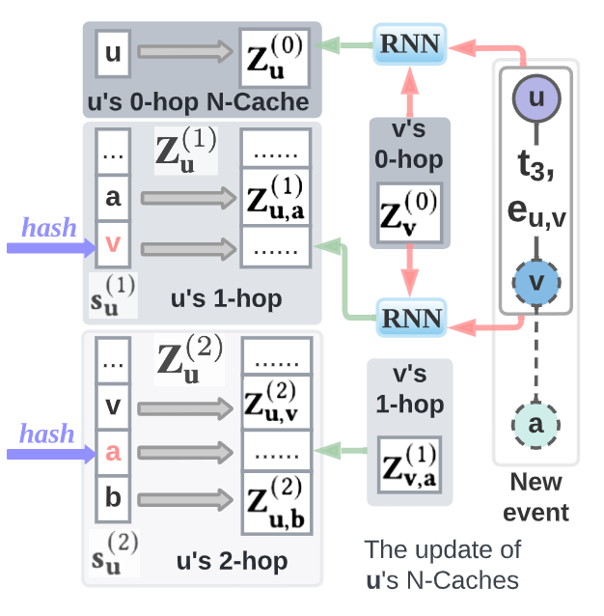
Neighborhood Cache (N-Cache)
Setting size limit
1-hop (16-40 nodes)
2-hop (0-20 nodes)
Parallel hashing
Addressing collisions
N-Cache of u
Notes:
On high level N-cache is a fixed size hashmap stored within GPU. It is benefit from three optimizations.
The first is simple, we only keep track of a subset of neighbors for each number of hops.
Second, we perform hashing for read and write for multiple nodes in parallel.
Third, we address collisions efficiently.

Slide 44
Neighborhood Cache (N-Cache)
Consider:
Setting size limit
1-hop (16-40 nodes)
2-hop (0-20 nodes)
Parallel hashing
Addressing collisions
N-Cache of u
Notes:
To explain the hashing, let’s consider we observe a new link u,v.

Slide 45
Neighborhood Cache (N-Cache)
Consider:
Stored within GPU to enable read and write for all nodes in parallel
Uses hashing to speed up
When a collision happens, we replace the old one with some probability
The hash replacement is equivalent to neighbor sampling
N-Cache of u
Notes:
2 mins

Slide 46
Takeaways
Structural features from a joint neighborhood of multiple nodes are crucial to predict temporal network evolution.
Dictionary-type representations can combine structural feature construction with traditional vector representations in an efficient way.
Neighborhood Caches manages the representations with parallel hashing in the GPU which further speeds up learning.
What’s next?
Potential in other node level tasks such as node classification, anomaly detection
Notes:
Okay. Let me briefly summarize the talk.
Here are some takeways.
Structural features from a joint neighborhood of multiple nodes such as triadic closure are crucial to predict temporal network evolution
However, CAWN that construct structural features is slow so we propose NAT that use dictionary-type representations to avoid the problem.
Dictionary-type representations can combine such structural feature construction with traditional vector representations
Dictionary-type representations allow online constructing such structural features in an efficient way

Slide 47
Two Computational Benefits
Consider:
Update 1-hop embeddings:
Rewrite node v into the dictionary
When a confliction happens, we do random drop.
Notes:
2 mins

Slide 48
Issues of Previous Approaches
Works over static graphs
SEAL (Zhang et al. 2018)
Distance encoding (Li et al. 2020)
Labeling trick (Zhang et al. 2021)
SUREL (Yin et al. 2022)
ELPH (Chamberlain et al. 2022)
Key idea: Construct structural features
[1,1]
Distance encoding
Take distance encoding (Li et al. 2020) as an example:
a
To make a prediction for (u,v), associate a with an extra feature [1,1] to denote its shortest path distances to both u and v are 1’s.
u
v
What is suitable for temporal networks? Effective & scalable
Distance encoding: design provably more powerful neural networks for graph representation learning, Li et al. NeurIPS 2020
Labeling trick: A theory of using graph neural networks for multi-node representation learning, Zhang et al. NeurIPS 2021
Notes:
This is not a new observation in the study of static networks.
Till now, many works on static networks have been proposed to address this issue.
The common idea behind these works is to construct structural features that involve the multiple nodes of interest.
Interested audient may want to check these work to know more details.
As an example, if we use distance encoding, when we make prediction for node pair u and v, we may label a as (1,1) as its shortest path distances to u and v are both 1.
The question is how to generalize this idea to temporal networks to guarantee the effectiveness and scalability.

Slide 49
Neighborhood-Aware Temporal Network (NAT)
How to represent a node in a temporal network?
Long-vector representation that encodes all temporal and spatial features?
Notes:
Now we introduce our approach. Our approach has two steps.

Slide 50
Neighborhood-Aware Temporal Network (NAT)
How to represent a node in a temporal network?
Long-vector representation that encodes all temporal and spatial features?
NO
Notes:
Now we introduce our approach. Our approach has two steps.

Slide 51
Issues of Previous Approaches (Scalability)
Computational Overhead of CAWN:
For each queried node pair, random walks need to be sampled.
The relative position encoding needs to be computed online.
0 hop 1 hop 2 hops
[(0, 1, 0), (0, 1, 0)]
Notes:
To motivate the second work, here we note that there is a huge computation overhead.
Basically, for each queried node pair, we need to sample walks and compute relative positional encoding online.
Both of these operations take time.
This problem is more severe in temporal networks because two nodes may interact many times

Slide 52
a
u
v
[(0, 1, 0), (0, 1, 0)]
0 hop 1 hop 2 hops

